Slide 1
How I became a Zeeker!
&
Why I Zeek

Slide 2
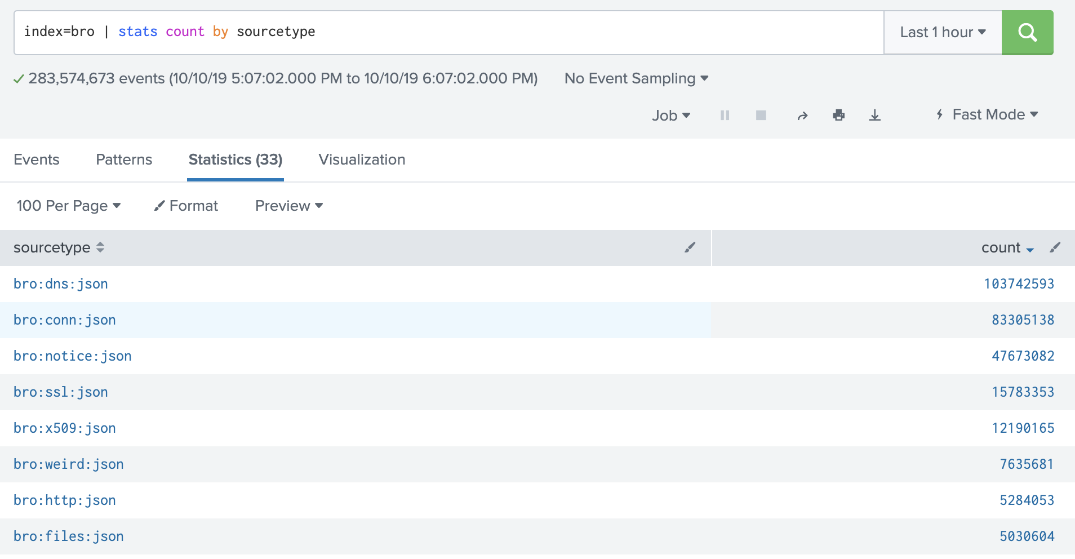

Slide 3
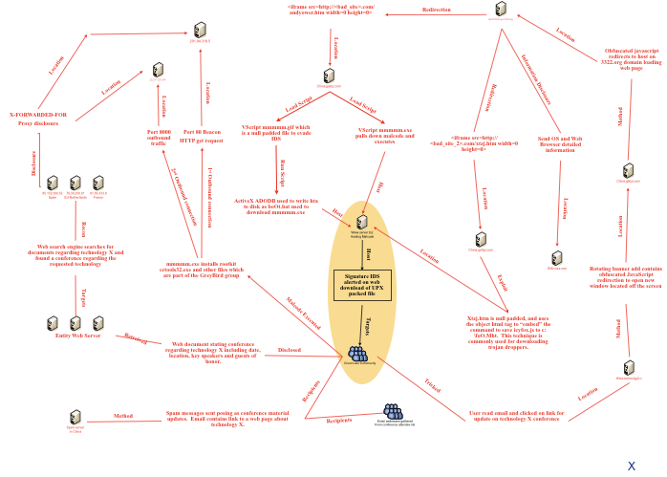

Slide 4
grep ^event events.bif
event http_request%(c: connection, method: string, original_URI: string, unescaped_URI: string, version: string%);
event http_reply%(c: connection, version: string, code: count, reason: string%);
event http_header%(c: connection, is_orig: bool, name: string, value: string%);
event http_all_headers%(c: connection, is_orig: bool, hlist: mime_header_list%);
event http_begin_entity%(c: connection, is_orig: bool%);
event http_end_entity%(c: connection, is_orig: bool%);
event http_entity_data%(c: connection, is_orig: bool, length: count, data: string%);
event http_content_type%(c: connection, is_orig: bool, ty: string, subty: string%);
event http_message_done%(c: connection, is_orig: bool, stat: http_message_stat%);
event http_event%(c: connection, event_type: string, detail: string%);
event http_stats%(c: connection, stats: http_stats_rec%);
event http_connection_upgrade%(c: connection, protocol: string%);

Slide 5
Event <event_name>(c: connection) {
print “#############”;
print “”;
print c;
print “”;
print “#############”;
# :o
}
Notes:
Where to start?

Slide 6
ized>, dns=<uninitialized>, dns_state=<uninitialized>, ftp=<uninitialized>, ftp_data_reuse=F, ssl=<uninitialized>, http=<uninitialized>, http_state=<uninitialized>, irc=<uninitialized>, krb=<uninitialized>, modbus=<uninitialized>, mysql=<uninitialized>, ntlm=<uninitialized>, ntp=<uninitialized>, radius=<uninitialized>, rdp=<uninitialized>, rfb=<uninitialized>, sip=<uninitialized>, sip_state=<uninitialized>, snmp=<uninitialized>, smb_state=<uninitialized>, smtp=<uninitialized>, smtp_state=<uninitialized>, socks=<uninitialized>, ssh=<uninitialized>, syslog=<uninitialized>, known_services_done=F, tlsfp=<uninitialized>, ja3sfp=<uninitialized>, hassh=<uninitialized>]
#######################
#######################
[id=[orig_h=172.20.5.38, orig_p=5353/udp, resp_h=224.0.0.251, resp_p=5353/udp], orig=[size=13878, state=1, num_pkts=33, num_bytes_ip=14802, flow_label=0, l2_addr=8c:85:90:1f:e2:53], resp=[size=0, state=0, num_pkts=0, num_bytes_ip=0, flow_label=0, l2_addr=01:00:5e:00:00:fb], start_time=1570723480.078298, duration=44.2345, service={
-DNS
}, history=D, uid=CyiNpV3X4wOwbuSbRg, tunnel=<uninitialized>, vlan=<uninitialized>, inner_vlan=<uninitialized>, dpd=<uninitialized>, conn=[ts=1570723480.078298, uid=CyiNpV3X4wOwbuSbRg, id=[orig_h=172.20.5.38, orig_p=5353/udp, resp_h=224.0.0.251, resp_p=5353/udp], proto=udp, service=<uninitialized>, duration=44.2345, orig_bytes=13878, resp_bytes=0, conn_state=S0, local_orig=<uninitialized>, local_resp=<uninitialized>, missed_bytes=0, history=D, orig_pkts=33, orig_ip_bytes=14802, resp_pkts=0, resp_ip_bytes=0, tunnel_parents=<uninitialized>, pcr=<uninitialized>], extract_orig=F, extract_resp=F, thresholds=<uninitialized>, dce_rpc=<uninitialized>, dce_rpc_state=<uninitialized>, dce_rpc_backing=<uninitialized>, dhcp=<uninitialized>, dnp3=<uninitialized>, dns=[ts=1570723480.999925, uid=CyiNpV3X4wOwbuSbRg, id=[orig_h=172.20.5.38, orig_p=5353/udp, resp_h=224.0.0.251, resp_p=5353/udp], proto=udp, trans_id=0, rtt=<uninitialized>, query=<uninitialized>, qclass=<uninitialized>, qclass_name=<uninitialized>, qtype=<uninitialized>, qtype_name=<uninitialized>, rcode=<uninitialized>, rcode_name=<uninitialized>, AA=F, TC=F, RD=F, RA=F, Z=0, answers=<uninitialized>, TTLs=<uninitialized>, rejected=F, total_answers=<uninitialized>, total_replies=<uninitialized>, saw_query=T, saw_reply=F], dns_state=[pending_query=[ts=1570723480.082706, uid=CyiNpV3X4wOwbuSbRg, id=[orig_h=172.20.5.38, orig_p=5353/udp, resp_h=224.0.0.251, resp_p=5353/udp], proto=udp, trans_id=0, rtt=<uninitialized>, query=reliant._device-info._tcp.local, qclass=32769, qclass_name=qclass-32769, qtype=16, qtype_name=TXT, rcode=<uninitialized>, rcode_name=<uninitialized>, AA=F, TC=F, RD=F, RA=F, Z=0, answers=<uninitialized>, TTLs=<uninitialized>, rejected=F, total_answers=<uninitialized>, total_replies=<uninitialized>, saw_query=T, saw_reply=F], pending_queries={
[0] = [initialized=T, vals={
[0] = [ts=1570723480.281838, uid=CyiNpV3X4wOwbuSbRg, id=[orig_h=172.20.5.38, orig_p=5353/udp, resp_h=224.0.0.251, resp_p=5353/udp], proto=udp, trans_id=0, rtt=<uninitialized>, query=haligonia.local, qclass=32769, qclass_name=qclass-32769, qtype=255, qtype_name=*, rcode=<uninitialized>, rcode_name=<uninitialized>, AA=F, TC=F, RD=F, RA=F, Z=0, answers=<uninitialized>, TTLs=<uninitialized>, rejected=F, total_answers=<uninitialized>, total_replies=<uninitialized>, saw_query=T, saw_reply=F],
[3] = [ts=1570723480.999925, uid=CyiNpV3X4wOwbuSbRg, id=[orig_h=172.20.5.38, orig_p=5353/udp, resp_h=224.0.0.251, resp_p=5353/udp], proto=udp, trans_id=0, rtt=<uninitialized>, query=<uninitialized>, qclass=<uninitialized>, qclass_name=<uninitialized>, qtype=<uninitialized>, qtype_name=<uninitialized>, rcode=<uninitialized>, rcode_name=<uninitialized>, AA=F, TC=F, RD=F, RA=F, Z=0, answers=<uninitialized>, TTLs=<uninitialized>, rejected=F, total_answers=<uninitialized>, total_replies=<uninitialized>, saw_query=T, saw_reply=F],
[2] = [ts=1570723480.793953, uid=CyiNpV3X4wOwbuSbRg, id=[orig_h=172.20.5.38, orig_p=5353/udp, resp_h=224.0.0.251, resp_p=5353/udp], proto=udp, trans_id=0, rtt=<uninitialized>, query=haligonia.local, qclass=1, qclass_name=C_INTERNET, qtype=255, qtype_name=*, rcode=<uninitialized>, rcode_name=<uninitialized>, AA=F, TC=F, RD=F, RA=F, Z=0, answers=<uninitialized>, TTLs=<uninitialized>, rejected=F, total_answers=<uninitialized>, total_replies=<uninitialized>, saw_query=T, saw_reply=F],
[1] = [ts=1570723480.591556, uid=CyiNpV3X4wOwbuSbRg, id=[orig_h=172.20.5.38, orig_p=5353/udp, resp_h=224.0.0.251, resp_p=5353/udp], proto=udp, trans_id=0, rtt=<uninitialized>, query=haligonia.local, qclass=1, qclass_name=C_INTERNET, qtype=255, qtype_name=*, rcode=<uninitialized>, rcode_name=<uninitialized>, AA=F, TC=F, RD=F, RA=F, Z=0, answers=<uninitialized>, TTLs=<uninitialized>, rejected=F, total_answers=<uninitialized>, total_replies=<uninitialized>, saw_query=T, saw_reply=F]
}, settings=[max_len=<uninitialized>], top=4, bottom=0, size=0]
}, pending_replies=<uninitialized>], ftp=<uninitialized>, ftp_data_reuse=F, ssl=<uninitialized>, http=<uninitialized>, http_state=<uninitialized>, irc=<uninitialized>, krb=<uninitialized>, modbus=<uninitialized>, mysql=<uninitialized>, ntlm=<uninitialized>, ntp=<uninitialized>, radius=<uninitialized>, rdp=<uninitialized>, rfb=<uninitialized>, sip=<uninitialized>, sip_state=<uninitialized>, snmp=<uninitialized>, smb_state=<uninitialized>, smtp=<uninitialized>, smtp_state=<uninitialized>, socks=<uninitialized>, ssh=<uninitialized>, syslog=<uninitialized>, known_services_done=T, tlsfp=<uninitialized>, ja3sfp=<uninitialized>, hassh=<uninitialized>]
#######################
#######################
[id=[orig_h=fe80::a100:970c:2145:c3e0, orig_p=136/icmp, resp_h=ff02::1, resp_p=135/icmp], orig=[size=24, state=1, num_pkts=1, num_bytes_ip=72, flow_label=0, l2_addr=a8:6d:aa:af:94:3e], resp=[size=0, state=0, num_pkts=0, num_bytes_ip=0, flow_label=0, l2_addr=33:33:00:00:00:01], start_time=1570723481.92045, duration=0.0, service={
Notes:
Now you’ll be able to see all of the details about the connection. Lots of data.

Slide 7
TTPs
Tools
Harder for threat actors to change
Even harder to detect
Artifacts
Domain Names
IP Addresses
Hash Values

Slide 8
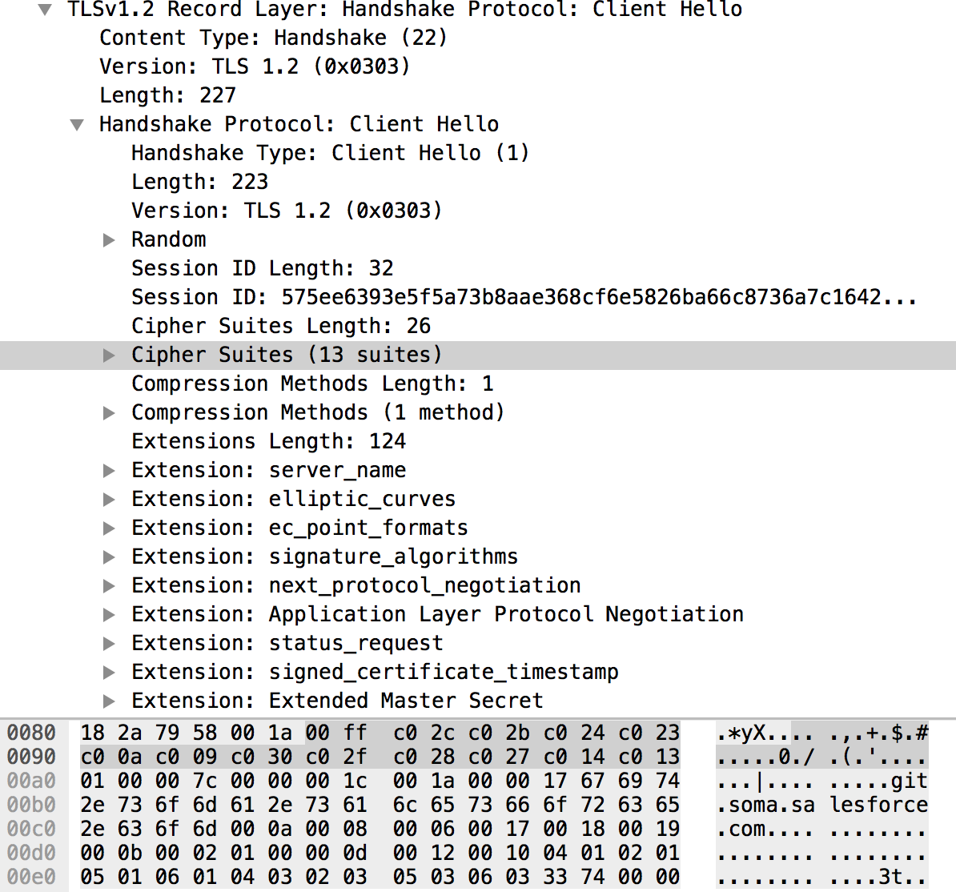
Fingerprinting TLS Clients
771,49196-49195-49200-49199-159-158-49188-49187-49192-49191-49162-49161-49172-49171-157-156-61-60-53-47-10,0-5-10-11-13-35-23-65281,29-23-24,0
JA3 = ce5f3254611a8c095a3d821d44539877

Slide 9
Baseline your environment
https://github.com/gbarford/testssl
Win10-socket: c12f54a3f91dc7bafd92cb59fe009a35
Win10-socket-SNI: 3b5074b1b5d032e5620f69f9f700ff0e
Win10-powershell: fc54e0d16d9764783542f0146a98b300
Win10-powershell-SNI: 54328bd36c14bd82ddaa0c04b25ed9ad
Win10-iexplore: be6155e945a3e59a1dd0841b86f6c945
Win10-iexplore-SNI: 10ee8d30a5d01c042afd7b2b205facc4
Win2016-socket: 043c543b63b895881d9abfbc320cb863
Win2016-socket-SNI: 7c410ce832e848a3321432c9a82e972b
Win2016-powershell: 17b69de9188f4c205a00fe5ae9c1151f
Win2016-powershell-SNI: 235a856727c14dba889ddee0a38dd2f2
Win2016-iexplore: 4f2e9c50db9bd107439136bd24740c0d
Win2016-iexplore-SNI: f88610704d61a237aa9e5e0849573998

Slide 10
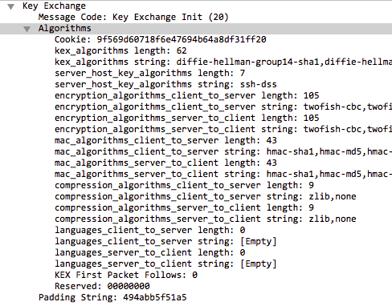
Fingerprinting SSH - The HASSH Method
curve25519-sha256@libssh.org,diffie-hellman-group-exchange-sha256,ecdh-sha2-nistp521,ecdh-sha2-nistp384,ecdh-sha2-nistp256,diffie-hellman-group-exchange-sha1,diffie-hellman-group1-sha1,diffie-hellman-group14-sha1,diffie-hellman-group14-sha256,diffie-hellman-group15-sha512,diffie-hellman-group16-sha512,diffie-hellman-group17-sha512,diffie-hellman-group18-sha512,diffie-hellman-group14-sha256@ssh.com,diffie-hellman-group15-sha256,diffie-hellman-group15-sha256@ssh.com,diffie-hellman-group15-sha384@ssh.com,diffie-hellman-group16-sha256,diffie-hellman-group16-sha384@ssh.com,diffie-hellman-group16-sha512@ssh.com,diffie-hellman-group18-sha512@ssh.com;aes128-cbc,aes128-ctr,aes192-cbc,aes192-ctr,aes256-cbc,aes256-ctr,blowfish-cbc,blowfish-ctr,cast128-cbc,cast128-ctr,idea-cbc,idea-ctr,serpent128-cbc,serpent128-ctr,serpent192-cbc,serpent192-ctr,serpent256-cbc,serpent256-ctr,3des-cbc,3des-ctr,twofish128-cbc,twofish128-ctr,twofish192-cbc,twofish192-ctr,twofish256-cbc,twofish256-ctr,twofish-cbc,arcfour,arcfour128,arcfour256;hmac-sha1,hmac-sha1–96,hmac-md5,hmac-md5–96,hmac-sha2–256,hmac-sha2–512;zlib@openssh.com,zlib,none
HASSH = 8a8ae540028bf433cd68356c1b9e8d5b

Slide 11
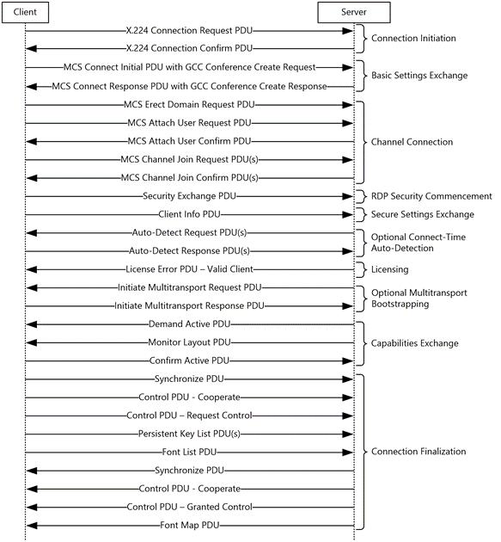
RDP Fingerprinting
join_string_vec(vector(cat(c$rdfp$verMajor),
cat(c$rdfp$verMinor),
c$rdfp$encMethods,
c$rdfp$clusterFlags,
cat(c$rdfp$extEncMethods),
c$rdfp$channelDef), rdfp_sep);
md5_hash(rdfp_string);

Slide 12
RDP Fingerprinting
join_string_vec(vector(cat(c$rdfp$verMajor),
cat(c$rdfp$verMinor),
c$rdfp$encMethods,
c$rdfp$clusterFlags,
cat(c$rdfp$extEncMethods),
c$rdfp$channelDef), rdfp_sep);
md5_hash(rdfp_string);

Slide 13
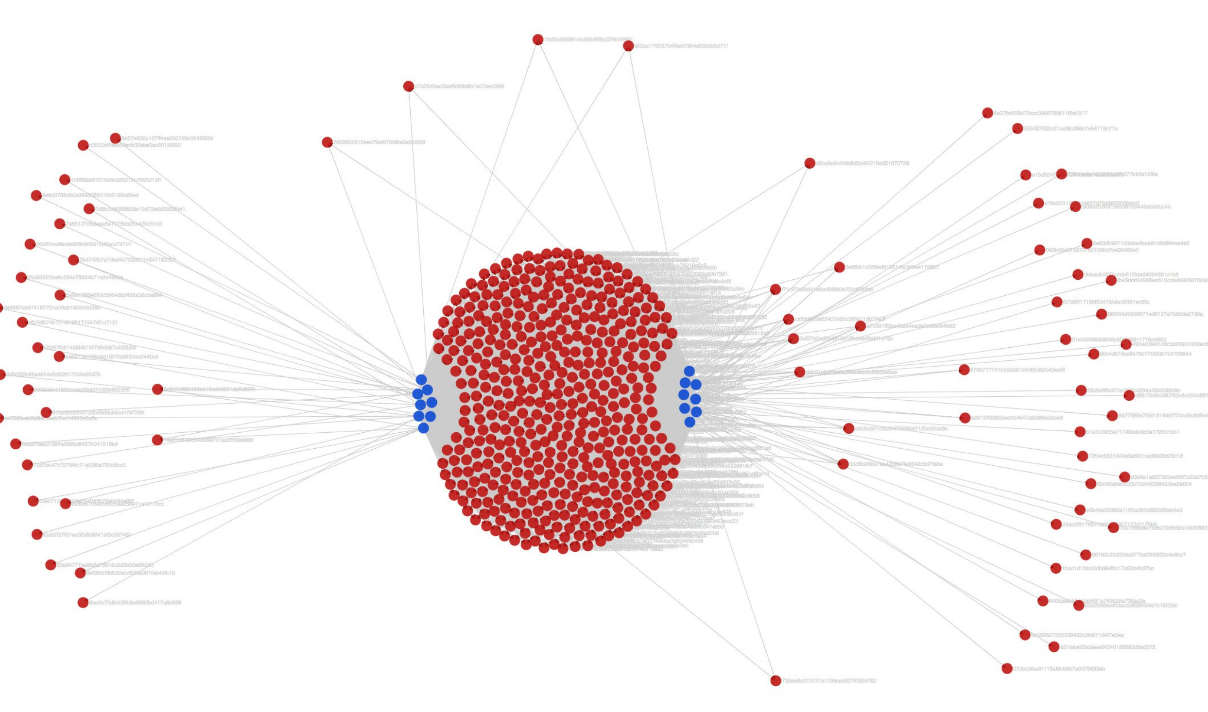

Slide 14
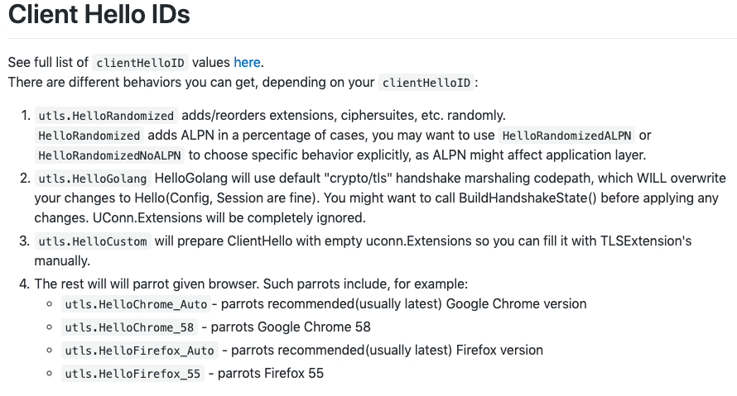
Client Hello Tooling - uTLS
https://github.com/refraction-networking/utls/README.md

Slide 15
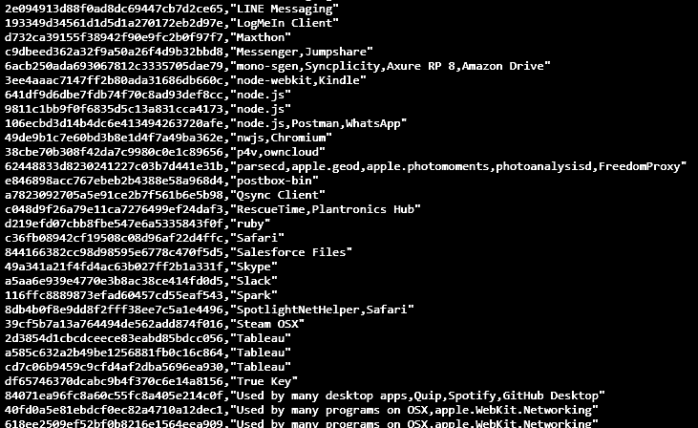
Mapping JA3 to Client Application

Slide 16
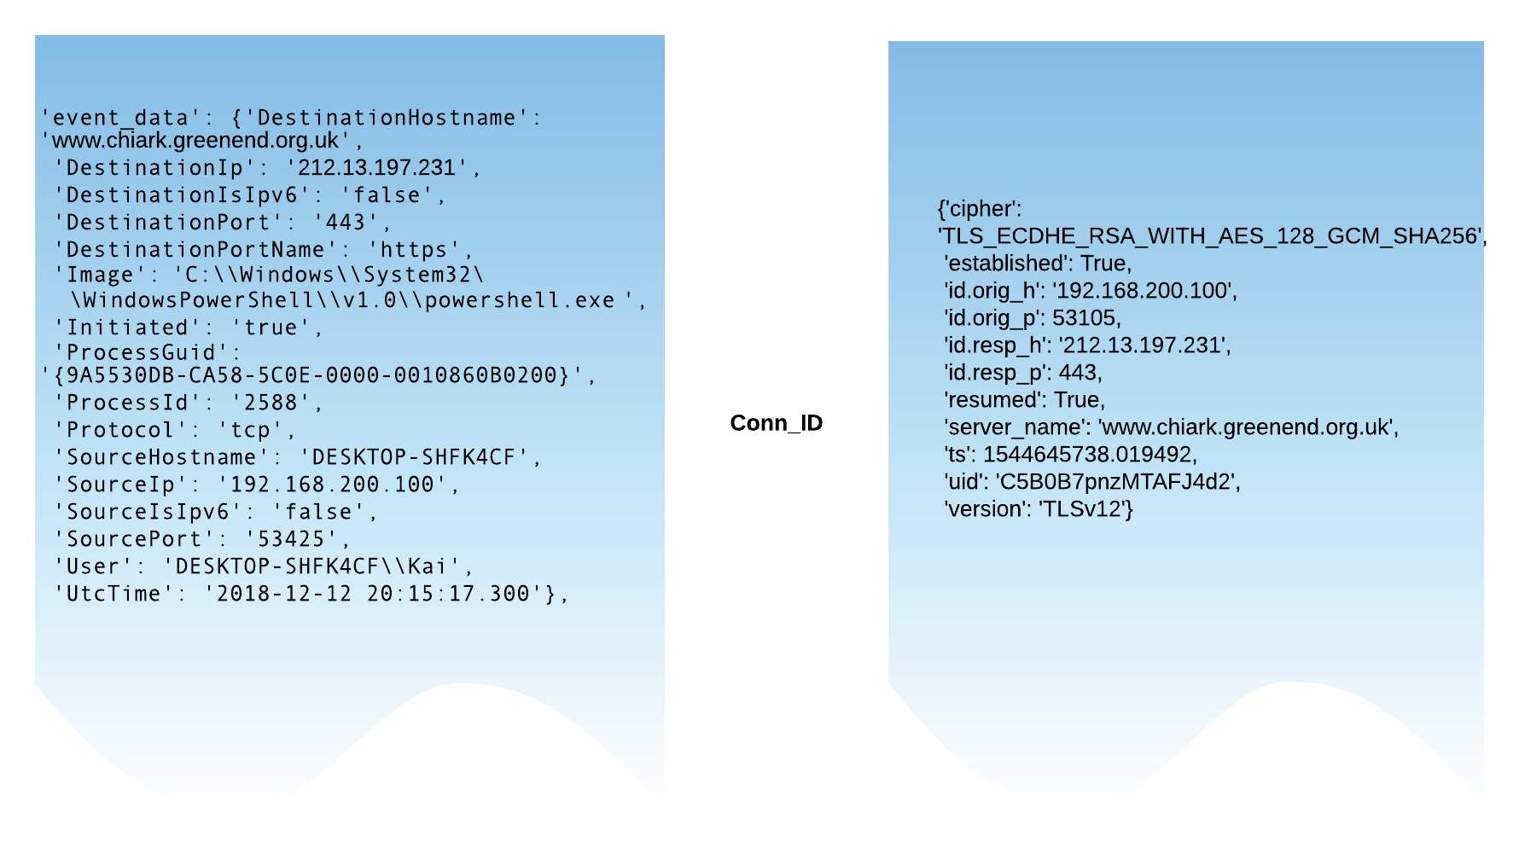
Bro-Sysmon
Notes:
Illustrate how Sysmon and Bro data are mapped together.

Slide 17
Bro-Sysmon
Notes:
Windows logs - WinLogBests - Logstash - Python - Zeek

Slide 18
Mapping JA3 to Client Application
search index=Bro_SSL DestinationPort=443 JA3!=null JA3Ciphers!=null ConnectionEstablished=true
| join SourcePort, DestinationPort, SourceAddr, DestinationAddr max=1 type=inner
[
search index=lots-o-logs sourcetype=OSQuery LogType=procs_on_internet Outcome=added SourcePort!=0 DestinationAddr!=0 IPSource!=0 DestinationPort=443 Protocol=6 ClientApplication!=null
| fields IPSource,SourcePort,DestionationAddr,DestinationPort,ClientApplication
]
| fields JA3, JA3Ciphers, ClientApplication
| stats values(ClientApplication) by JA3
index=bro sourcetype=bro:ssl:json | rename id.orig_h AS SourceAddressIP4 | rename id.orig_p AS LocalPort | rename id.resp_h AS RemoteAddressIP4 | rename id.resp_p AS RemotePort | join SourceAddressIP4,LocalPort, RemoteAddressIP4, RemotePort [
| search index=crowdstrike_falcon event_simpleName=Net* NOT ("0.0.0.0") LocalAddressIP4=* LocalAddressIP4!=127.0.0.1
| rename ContextProcessId AS SourceProcessId
| table LocalAddressIP4 LocalPort RemoteAddressIP4 RemotePort SourceProcessId
| join SourceProcessId [
| search index=crowdstrike_fdr event_simpleName=*Rollup*
| table SourceProcessId ImageFileName CommandLine
]
]
| table LocalAddressIP4 LocalPort RemoteAddressIP4 RemotePort ImageFileName]
| table LocalAddressIP4 LocalPort RemoteAddressIP4 RemotePort ImageFileName ja3 ja3s

Slide 19
https://github.com/cisco/mercury
{"str_repr": "(0303)(0a0a130113021303c02bc02fc02cc030cca9cca8c013c014009c009d002f0035000a)((0a0a)(0000)(0017)(ff01)(000a000a00080a0a001d00170018)(000b00020100)(0023)(0010000e000c02683208687474702f312e31)(000500050100000000)(000d00140012040308040401050308050501080606010201)(0012)(0033)(002d00020101)(002b000b0a0a0a0304030303020301)(001b)(0a0a)(0015))", "md5_repr": "e50fbf9a5858a6a46f6721014e10ec11", "source": ["Cisco"], "max_implementation_date": "2018-10", "min_implementation_date": "1999-01", "tls_features": {"version": "TLS 1.2", "cipher_suites": ["GREASE", "TLS_AES_128_GCM_SHA256", "TLS_AES_256_GCM_SHA384", "TLS_CHACHA20_POLY1305_SHA256", "TLS_ECDHE_ECDSA_WITH_AES_128_GCM_SHA256", "TLS_ECDHE_RSA_WITH_AES_128_GCM_SHA256", "TLS_ECDHE_ECDSA_WITH_AES_256_GCM_SHA384", "TLS_ECDHE_RSA_WITH_AES_256_GCM_SHA384", "TLS_ECDHE_ECDSA_WITH_CHACHA20_POLY1305_SHA256", "TLS_ECDHE_RSA_WITH_CHACHA20_POLY1305_SHA256", "TLS_ECDHE_RSA_WITH_AES_128_CBC_SHA", "TLS_ECDHE_RSA_WITH_AES_256_CBC_SHA", "TLS_RSA_WITH_AES_128_GCM_SHA256", "TLS_RSA_WITH_AES_256_GCM_SHA384", "TLS_RSA_WITH_AES_128_CBC_SHA", "TLS_RSA_WITH_AES_256_CBC_SHA", "TLS_RSA_WITH_3DES_EDE_CBC_SHA"], "extensions": [{"GREASE": ""}, {"server_name": ""}, {"extended_master_secret": ""}, {"renegotiation_info": ""}, {"supported_groups": {"supported_groups_list_length": 8, "supported_groups": ["GREASE", "x25519", "secp256r1", "secp384r1"]}}, {"ec_point_formats": {"ec_point_formats_length": 1, "ec_point_formats": ["uncompressed"]}}, {"session_ticket": ""}, {"application_layer_protocol_negotiation": ["h2", "http/1.1"]}, {"status_request": {"certificate_status_type": "ocsp", "responder_id_list_length": 0, "request_extensions_length": 0}}, {"signature_algorithms": {"signature_hash_algorithms_length": 18, "algorithms": ["ecdsa_sha256", "rsa_pss_sha256", "rsa_sha256", "ecdsa_sha384", "rsa_pss_sha384", "rsa_sha384", "rsa_pss_sha512", "rsa_sha512", "rsa_sha1"]}}, {"signed_certificate_timestamp": ""}, {"key_share": ""}, {"psk_key_exchange_modes": {"psk_key_exchange_modes_length": 1, "psk_key_exchange_mode": "psk_dhe_ke"}}, {"supported_versions": {"supported_versions_list_length": 10, "supported_versions": ["GREASE", "TLS 1.3", "TLS 1.2", "TLS 1.1", "TLS 1.0"]}}, {"compress_certificate": ""}, {"GREASE": ""}, {"padding": ""}]}, "process_info": [{"process": "chrome.exe", "application_category": "browser", "prevalence": 0.57, "sha256": "1FA5A6C8438A4E6D373D39C96B77C0C84540D38B80628EFFDEC89E77D02D7E57"}, {"process": "Google Chrome", "application_category": "browser", "prevalence": 0.18, "sha256": "2074E9B822A4AF37A4677D8B1DD0534EA96CE9B042F8FCD7FA83045C2B8AE635"}, {"process": "chrome.exe", "application_category": "browser", "prevalence": 0.06, "sha256": "A31C76B026966D8A01BB929402B17A5C0B35037CF53908770D7F3D1F28F6A7BD"}], "os_info": [{"os": "WinNT", "os_version": "10.0.17134", "os_edition": "Windows 10 Enterprise", "prevalence": 0.51}, {"os": "WinNT", "os_version": "6.1.7601", "os_edition": "Windows 7 Enterprise", "prevalence": 0.16}, {"os": "Mac OS X", "os_version": "10.14.2", "os_edition": "Mojave", "prevalence": 0.08}]}

Slide 20
Zeek all the things!
Jeff Atkinson
@4a7361
in/annh

