Slide 1


AEONIK™ SECURITY FABRIC
Zeek Based IPS
ZeekWeek - October 2019
Notes:
Aeonik was designed to revolutionize enterprise security.
It is a scalable, software-based IDPS solution for today’s networks and security challenges…and tomorrow’s.

Slide 2
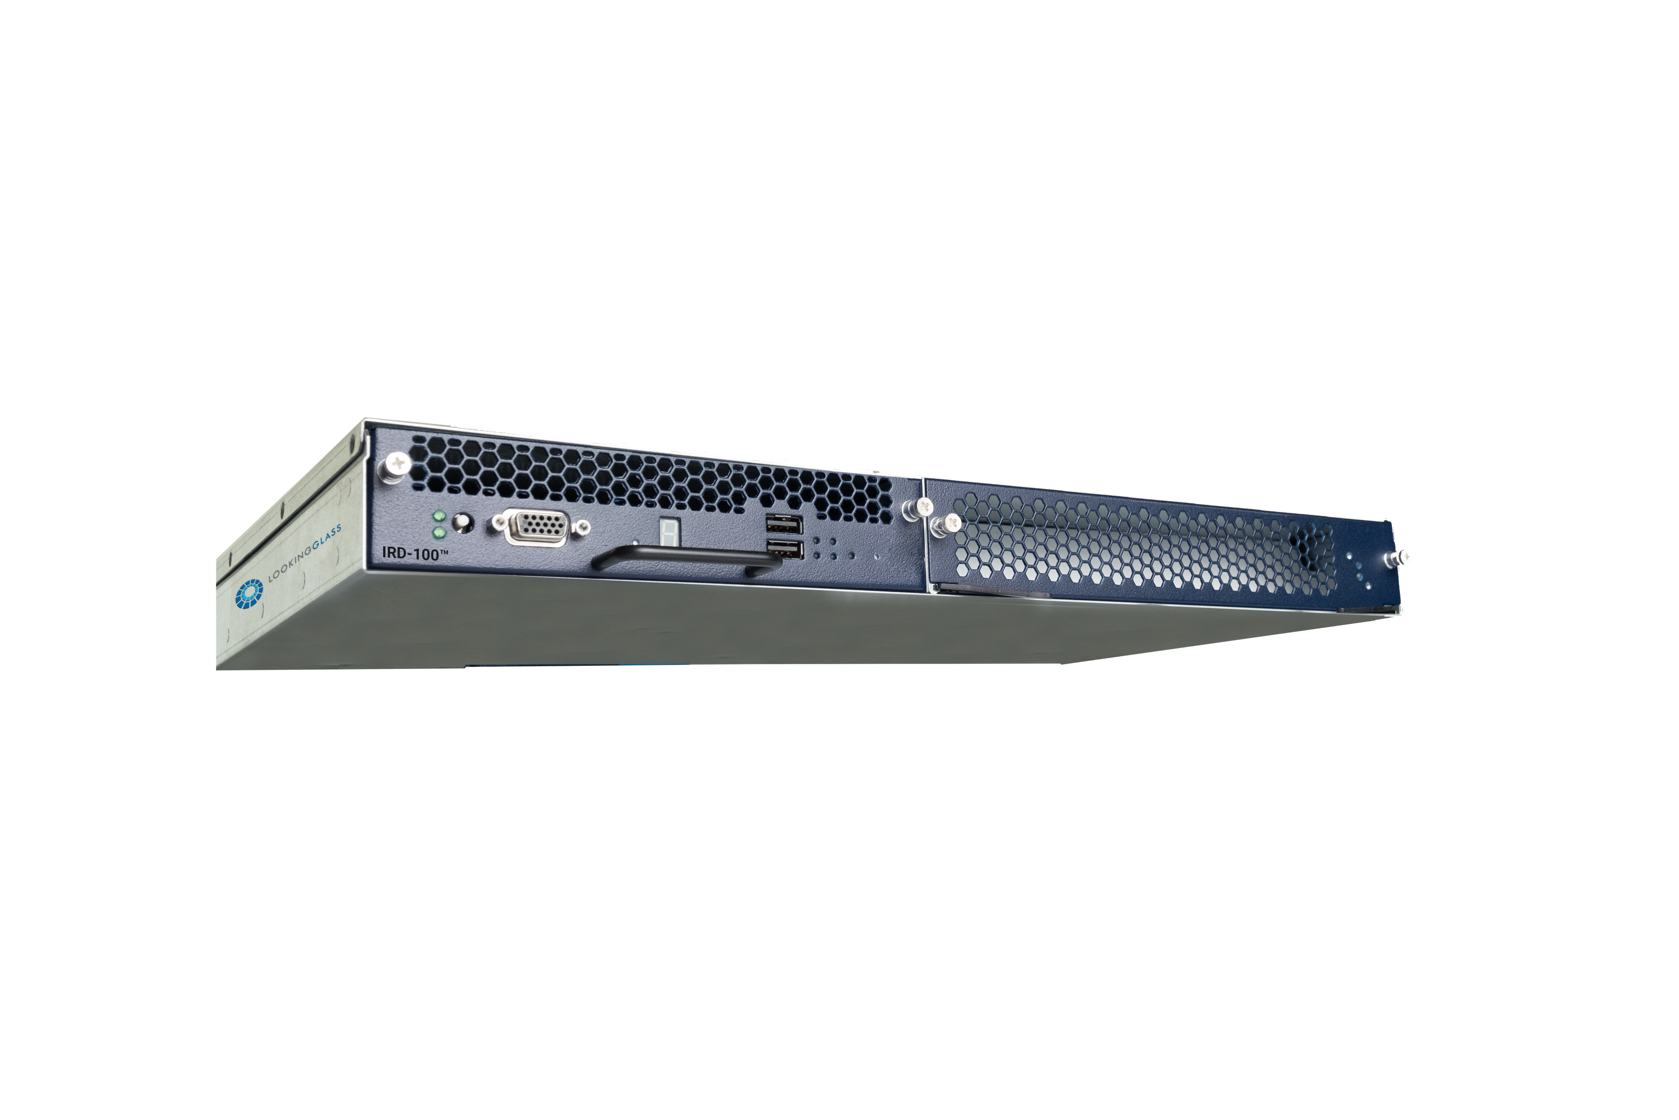
LookingGlass History
20+ years providing DPI & DPM solutions on special purpose hardware
Deployed and defending some of the most secure networks against the most advanced adversaries
27 Patents
Threat centric company
Threat Intelligence production & distribution
Notes:
For over 20 years, we have provided high speed deep packet inspection and manipulation capabilities for government customers using specialized FPGA based hardware. We have now virtualized that technology and put Zeek behind it, creating the first true Zeek based IPS.

Slide 3

Customer Security Challenges
Changing Topology
Technical Complexity
SDN
Hybrid/Cloud
Borderless
Highly segmented
Access needs from permissive
to ultra-restricted
Tool proliferation
Skills & Training
Need for greater visibility
Multiple detection methods a must
Operational Efficiency
Evolving Threatscape
Staff shortages
Turnover
Integration challenges
Cost penalty for h/w solutions
Velocity
Diversity
Sophistication
Automation
Notes:
Throughout the cybersecurity industry there are several common themes condensed into four major customer challenges – changing network topology, exploding complexity and brittleness of the tech stack, vendor and tool proliferation and of course, advances by the adversary

Slide 4

Providing Next-Generation Sensing and Threat Response Architecture
An interoperable fabric that combines traffic analysis
with behavioral, policy and signature-based detection with Zeek at its core.
Notes:
And many more features, engines, and capabilities to come.

Slide 5
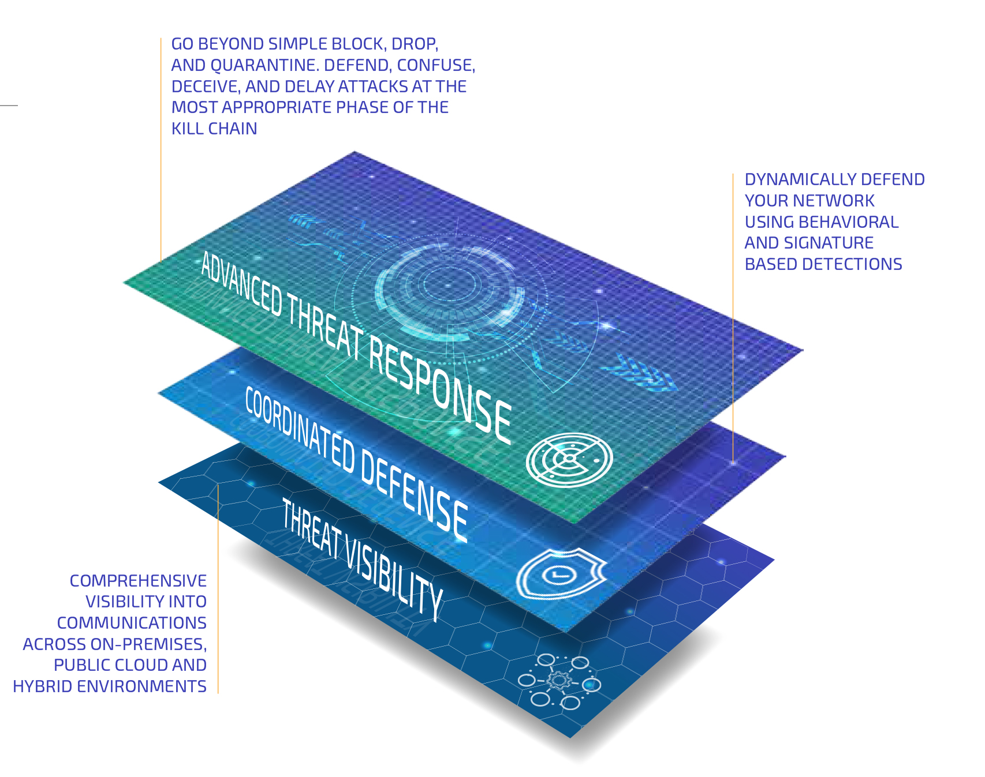
Aeonik Security Fabric
Notes:
Built on a SDN based fabric based architecture from the ground up allows Aeonik components the ability to communicate for detection and mitigation coordination. Aeonik integrates with OpenFlow and provides comprehensive network visibility mainly provided by Zeek and advanced threat responses.

Slide 6
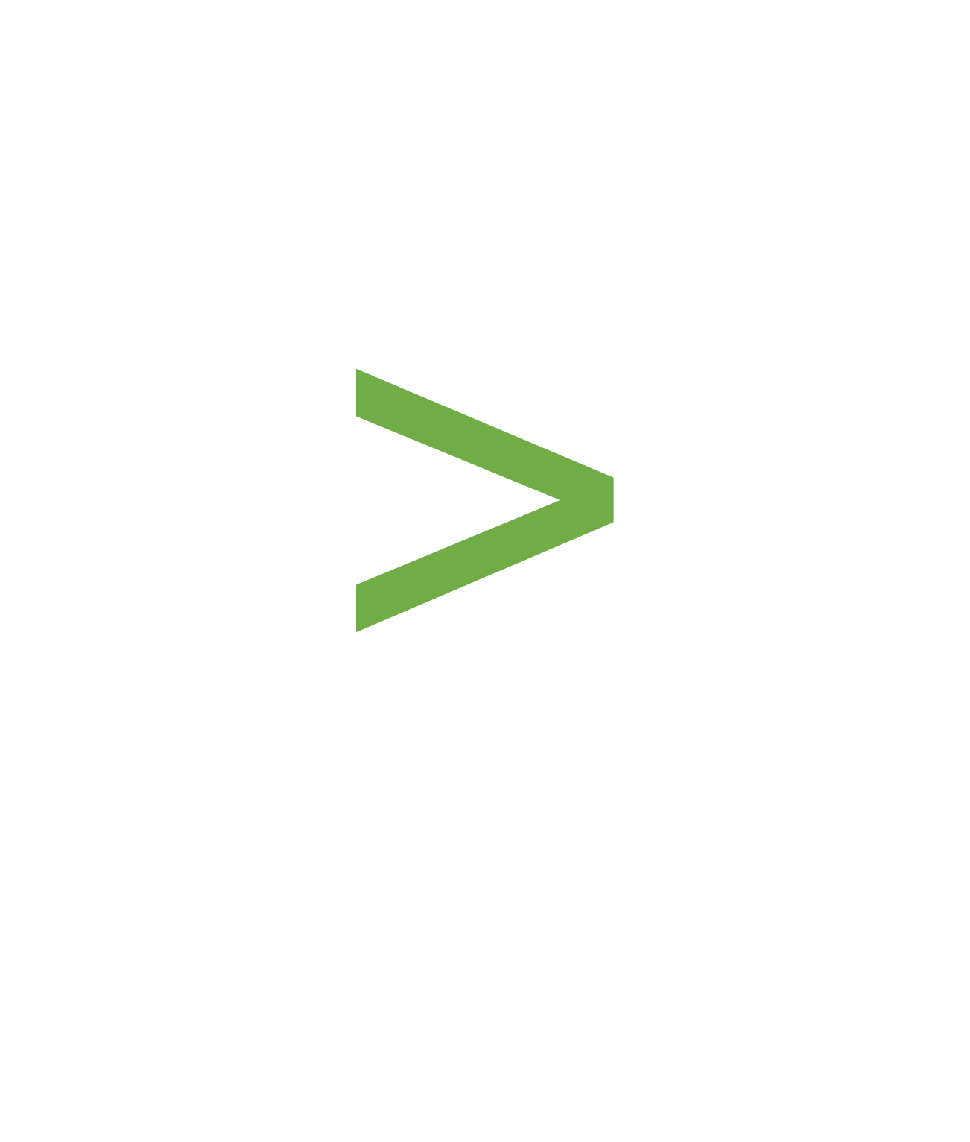
Simplify the Stack, Reduce Complexity
Intrusion Detection System (IDS)
Intrusion Prevention System (IPS)
Threat Intelligence Gateway (TIG)
Network Traffic Analysis (NTA)
Passive Asset Inventory
with more to come…
AEONIK™ SECURITY FABRIC
Notes:
This architecture can progressively take on more and more duties, and replace various legacy point solutions over time simply by advancing the software capabilities deployed in the fabric. On first release the fabric is able to perform duties of IDS, IPS, TIG, NTA, and asset collection.

Slide 7
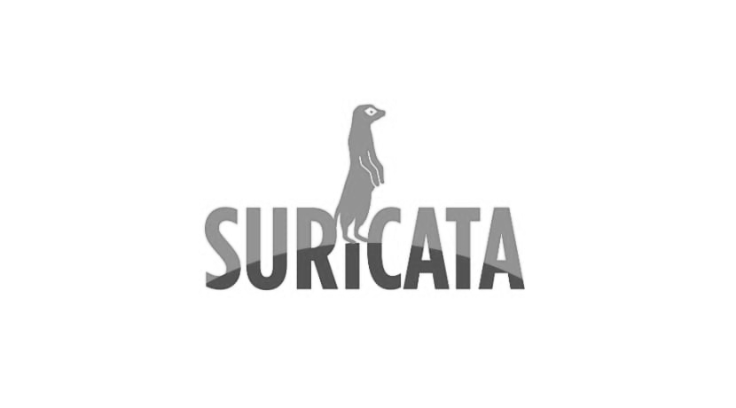
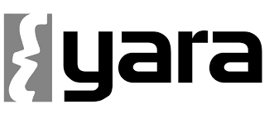


Aeonik: Sensing Engines
Notes:
We chose Zeek as our primary detection engine for its ease of extensibility and behavioral detection capabilities. Other detection engines coming soon, to include Surricata, Snort, Yara, sandboxing, ML, AI, etc. all with Zeek at its core.

Slide 8
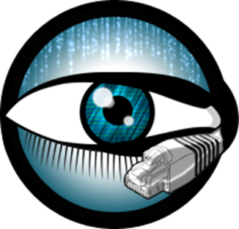
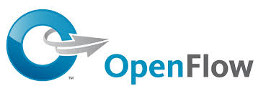



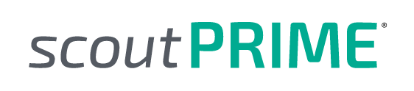
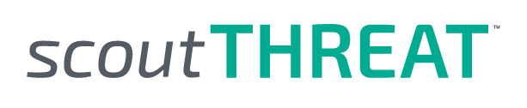
Standards-Based, Integration-Ready
Notes:
Aeonik is built on top of some of the most trusted standards for interoperability and trust tools that the industry already sees value in, such as Zeek. Built on open standards and trusted tools, Aeonik uses the people, skills, and tools you have in-hand to leverage current and future investments.

Slide 9
Aeonik: Zeek Action Framework
Notes:
We’ve created the Action framework, which allows you to trigger mitigation responses directly from your existing Zeek script by adding 2 lines of code. You can specify criteria including connection ID, 5-tuple, VLAN, etc. as well as specifying the action to take on the traffic matching the criteria. Now Zeek detections directly trigger mitigation responses, no third party integrations or orchestration required.

Slide 10
Aeonik: Zeek Scripts
Notes:
With the new Action framework, we started with taking the great scripts already included with Zeek and added mitigation to those that made sense. This includes Heartbleed, TCP scanning, Brute force detections, vulnerability DNS hijacking, policy based detections, and many more. All existing Zeek scripts are compatible with Aeonik. Easy custom script integration coming soon.

Slide 11
Aeonik: Zeek Intel Framework
100+ million indicators
Notes:
We have rewritten the Zeek Intel framework to handle 100 million indicators and contain STIX/TAXII 2.1 integration for native Lookingglass and third party Threat Intelligence integration.

Slide 12


Mitigation Actions Beyond a Simple Block
AEONIK NETWORK NODE
Transparent Reroute
Notes:
Our mitigation actions go behind the simple block or allow, and focus on the advancing the state of defense. This includes TCP Reset, DNS redirection, and transparent reroute as shown here. With transparent route, we are able to manipulate inline packets rerouting them into honey pots or deception technologies. This allows us to turn the tide on the adversary making them waste time and resources thinking they are successful.

Slide 13
Built in Orchestration
Notes:
As an industry we need to lessen the time between detection and response. Orchestration at the level of the SIEM will never catch patient zero. By the time the sensor has alerted, SIEM performs analytics and thresholding, and orchestrates some in line component, the packets have already passed and the session has most likely closed.

Slide 14
Dynamic Zone Protection
Notes:
Being deployed in a fabric architecture, a detection in one node may trigger mitigation instantiations in any or all nodes by defined Zones.

Slide 15
Deployment Options
Stealth
Address
(Transparent)
(Non-transparent)
Notes:
Our Network Node, the point of presence on the network providing both visibility, detection, and response, may be deployed either stealth or address mode. Stealth mode provides Layer 2&3 transparency, while Address mode allows the ability to assign both MAC and IP addresses to the dataplane, as required by some cloud environments.

Slide 16
Deployment Options
Stealth
Address
(Transparent)
(Non-transparent)
Bare Metal
(physical port mapping)
Bare Metal
(virtual port mapping)
(aggregated port)
(per port)
Notes:
Current deployments include bare metal commodity x86 hardware or Vmware for both Stealth and Address modes, with AWS coming in upcoming release.

Slide 17
Why Aeonik Security Fabric?
Can be deployed anywhere
on the network—not just at the perimeter, but laterally—for full N/S and E/W visibility
No specialized hardware;
software-based
Leverage open source community
utilizes Zeek IDS capabilities
Dynamic Zone
Protection
for automated,
coordinated responses
Gather intelligence
on attacks
with advanced response options of
re-direction, transparent re-routing
Proprietary stealth deployment
w/no Layer 2(MAC) or Layer 3(IP)
presence for adversaries to detect
Notes:
The key takeaways from Aeonik are the following.

Slide 18
Passive
&
Active
Notes:
We as an industry and community need to stop thinking of Zeek as just a passive collector and sensor technology, because with Lookingglass Aeonik, it no longer is.

Slide 19





https://www.lookingglasscyber.com/products/automated-threat-response/aeonik-security-fabric/
Thank You
LookingGlassCyber.com
@LookingGlassCyber
@LG_Cyber
/company/LookingGlass
/LookingGlassCyber
Notes:
If you are interested, stop by the booth and I’ll be happy to answer any questions and show you a live demo of inline Zeek.

