Slide 1
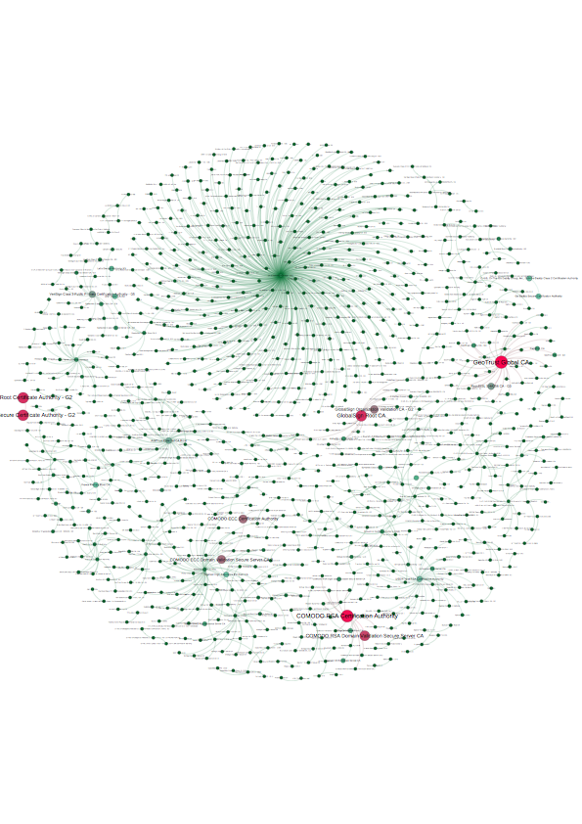

Using Bro for SSL Research
Johanna Amann
International Computer Science Institute
johanna@icir.org
http://www.icir.org/johanna

Slide 2





Bro History
Host Context
Time Machine
Enterprise Traffic
Academic Publications
Certificate
Transparency,
Long-term SSL Study
Tor SSL
OCSP Speed
Certificate Ecosystem
TLS Electronic Comm.
Spicy
TRW
State Mgmt.
Independ. State
Summary Stats
HILTI
DPI Concurrency
PLC Modeling
Android Root Certs
Heart bleed
Bro Cluster
Shunt
HTTPS Security
Anonymizer
Active Mapping
Context Signat.
NetControl
VAST
BinPAC
DPD
2nd Path
Autotuning
Parallel Prototype
Input Framework
Backdoors Stepping Stones
SSL Trust
SSL Errors
USENIX Paper
1995
1996
1997
1998
1999
2000
2001
2002
2003
2004
2005
2006
2007
2008
2009
2010
2011
2012
2013
2014
2015
2016
2017
2018
v2.4
Broker, Plugins, DTLS/KRB
OCSP, SCT,
ERSPAN
v2.0
User Experience
v2.2
File Analysis
Summary Stats
v2.5,
SMB, NetControl,
VNC, StartTLS
v2.6
Broker default, Config Framew., NFS updates
OpenSSL 1.1
Vern writes 1st line of code
v0.2
1st CHANGES
entry
v0.6
RegExps
Login analysis
v0.7a90
Profiling
State Mgmt
v0.8aX/0.9aX
SSL/SMB
STABLE releases
BroLite
v1.1/v1.2
when Stmt
Resource tuning
Broccoli
DPD
v1.5
BroControl
Bro SDCI
v2.1
IPv6
Input Framew.
v2.3
Performance
SNMP,
Radius, SSL++
LBNL starts using Bro
operationally
v0.4
HTTP analysis
Scan detector
IP fragments
Linux support
v0.7a175/0.8aX
Signatures
SMTP
IPv6 support
User manual
v1.0
BinPAC
IRC/RPC analyzers
64-bit support
Sane version numbers
v1.4
DHCP/BitTorrent
HTTP entities
NetFlow
Bro Lite Deprecated
Bro Center
v0.7a48
Consistent CHANGES
0.8a37
Communication
Persistence
Namespaces
Log Rotation
v1.3
Ctor expressions
GeoIP
Conn Compressor
Notes:
Bro - research driven development

Slide 3
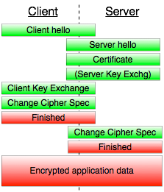
SSL
Notes:
Current state. How did we get there?

Slide 4
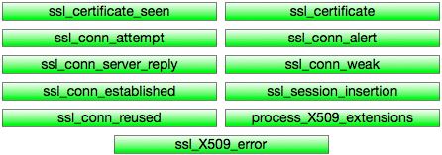
Bro SSL - v1.5.3
Notes:
Two different SSL analyzers (one in binpac, one in C++)
Rather bare-bones, lots of problems

Slide 5
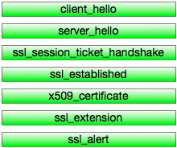
Bro SSL - v2.0, v2.2
Notes:
to 2012
Complete rewrite by Seth and Robin.
Got rid of a lot of “odd” events, cleaner, seems to make more sense.
Fix a lot of bugs (including eternal looping), memory leaks, segmentation faults

Slide 6
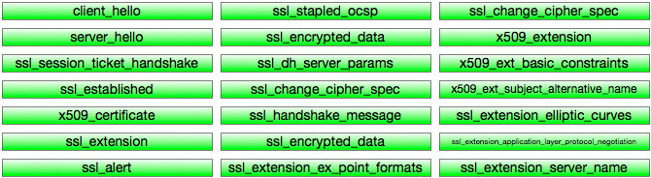
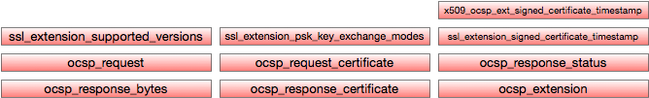
Bro SSL Events - v2.6
Notes:
2016/17
Working OCSP support
Signed Certificate Timestamp support (for Certificate Transparency)
More TLS 1.3 support.

Slide 7

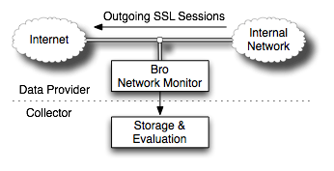
ICSI Notary
Notes:
Project that drove this - Notary

Slide 8
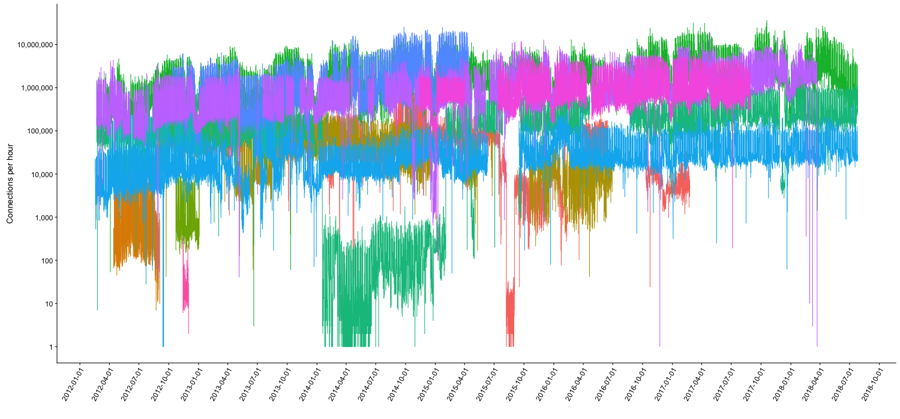
Notary - Connections
Notes:
Certificates: 16,506,629 (non-exp 6,141,599, valid 2,373,690)
Conns: 257,877,898,245, 443: 238,921,562,882

Slide 9
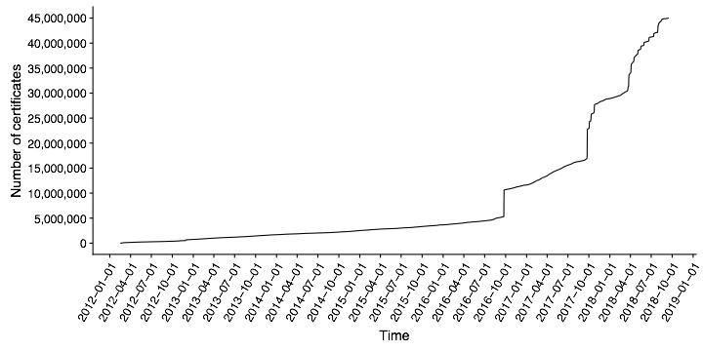
Notary - Certificates
Notes:
More than 5 million unique certificates (1.9 million not expired, 1.1 million valid)

Slide 10
Coming of Age
Longitudinal Study of TLS Deployment
Notes:
Reason why Bro will support OCSP - code currently research quality
Reason for research - current state of revocation checking, CRLsets, “OCSP considered broken”

Slide 11
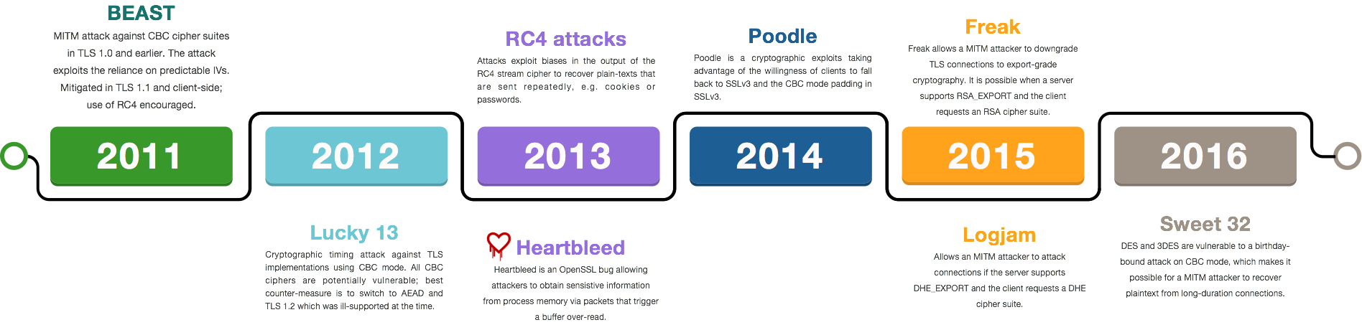
Major SSL attacks in the last years

Slide 12
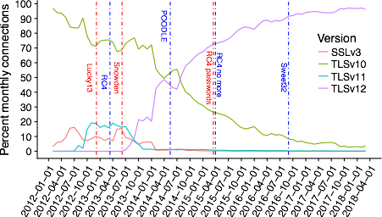
SSL Versions (negotiated)
Notes:
2 - 1995, 3 1996, 1.0 1999, 1.1 2006, 1.2 2008, 1.3 2018
Censys: in Sep- tember 2015, more than 45% of servers still supported SSL 3. The number has decreased since then—as of the beginning of May 2018, less than 25% of servers support SSL 3.

Slide 13
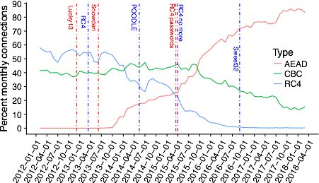
RC4, CBC or AEAD (negotiated)
Notes:
CBC attacks: BEAST (2011), Lucky 13 (2013), and POODLE

Slide 14
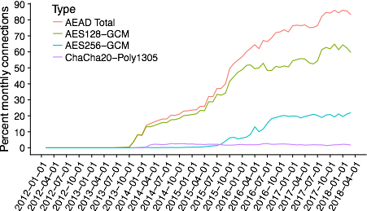
AEAD connection types

Slide 15
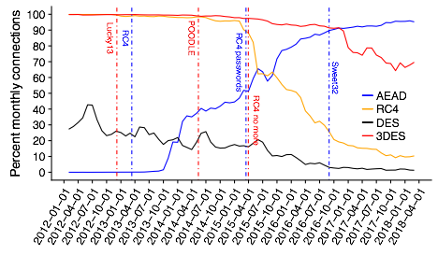
RC4, (3)DES, AEAD (advertised)
Notes:
CBC always > 100%
Sweet32 - DES/3DES

Slide 16
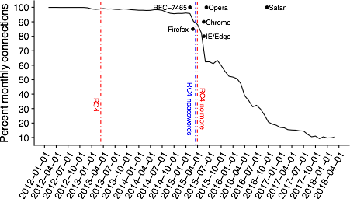
Conns. advertising RC4

Slide 17
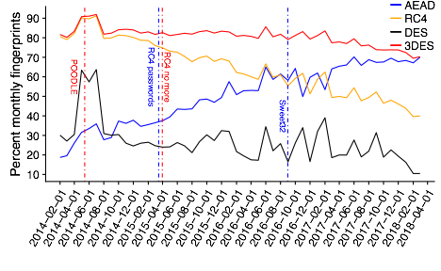
TLS Fingerprints AEAD/RC4/(3)DES

Slide 18
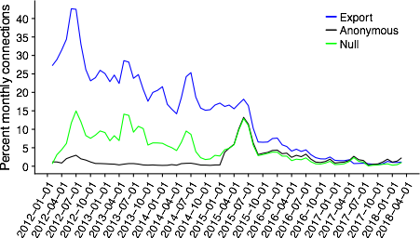
Export/Anon/NULL advertised

Slide 20
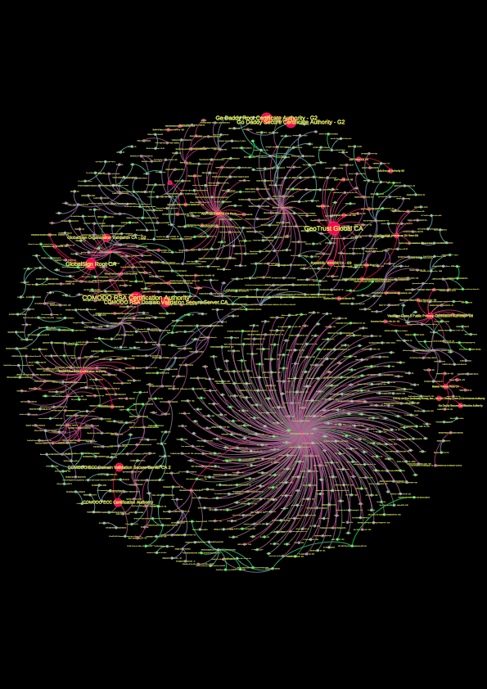
Notes:
NOTARY!
Thank current providers! Ask for new providers!

