Slide 1

Network Data Enrichment
For Analysis and Hunting

Slide 2
Agenda
Talk about challenges we face as network defenders
Share a new Bro module
Talk about some use-cases

Slide 3
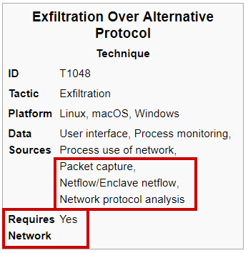
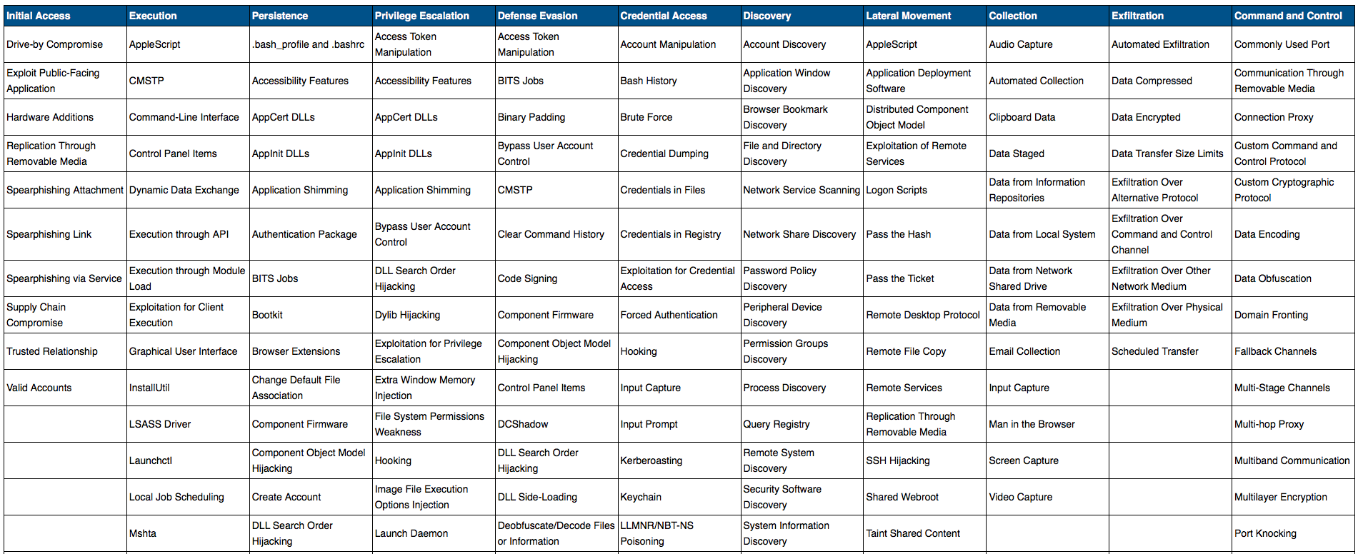
Threat actors have lots of options
MITRE ATT&CK Matrix: https://attack.mitre.org/wiki/Main_Page

Slide 4
Detection has a common theme
Network threat hunting techniques can help
Look for abnormal network host behavior
Normal depends on the host
Requires a strong understanding of the environment, host functions, applications and services

Slide 5
The Analyst’s Dilemma
Must identify threats for which there is no signature
Must distinguish normal vs abnormal in the environment
Must have knowledge of - and experience in - the environment
This is difficult to acquire and retain
Notes:
Knowledge and experience are critical in our trade
This is difficult to acquire and retain
Some mechanisms available to help
We can do more with Bro!
We don’t know what we don’t know… but as we learn we find out how much more there is to know.

Slide 6
Our understanding of normal improves over time…
Connections
Unknown
Known
Time

Slide 7
We’re doing better… then
Analyst leaves
Connections
Unknown
Known
Time

Slide 8
Now Its The Org’s Problem Too
An analyst’s experience and knowledge leaves with them
How does an organization retain and transfer that knowledge?
Can the individual human factor in all this be minimized?
Notes:
Analysts learn about their environments as a byproduct of fulfilling their duties
This institutional knowledge typically leaves with them when they take a different job
How do you retain and transfer that knowledge from person-to-person?
Can the human factor in all this be minimized? Dare I say… automated?

Slide 9
Data Enrichment is one way…
    “The action of improving or enhancing the quality or value of something"
Capture the contextual knowledge that allows analyst to draw informed conclusions
Fuse it with other data sets and make it available to our analysis tools

Slide 10
Why Context Matters
Reduce manual workflows
Shrink the new analyst learning curve
Enable informed analysis
Notes:
Captain obvious

Slide 11
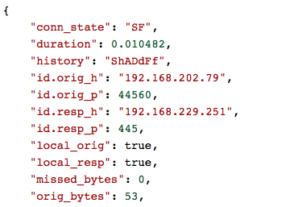
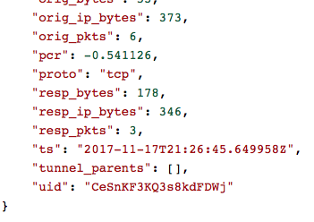
What’s going on here?
VPN Client Pool
Prod SQL Server

Slide 12

Methods of Enrichment
Traffic Inspection
Log Streams
Index/Store
Manual Processes
ETL
DB Joins
Wikis/KB’s
Transport
Lookup Tables
Spreadsheets
Post-processing
Ticketing Systems

Slide 13
Intel Framework
Real-time matching of 11 native indicator types (easily extended, ex JA3)
Customize to additional context along with the indicator
  Source
  Actor
  Campaign
  Incident number
Great for bad things, but…

Slide 14
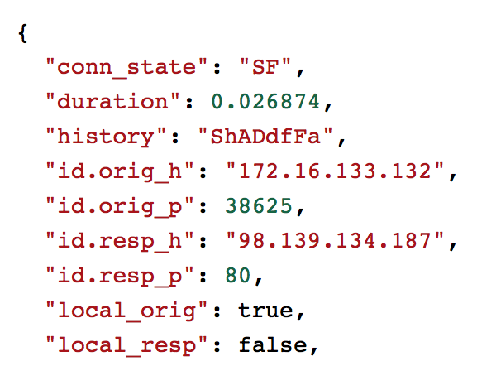
Site Module
User defines local subnets and domains
Conn records are auto-enriched
Convenience functions for testing locality
Provides important context but its limited
Notes:
user-provided information about local subnets and domains is used to determine their location relative to the monitored network
conn records are auto-enriched with the local_orig and local_resp fields, is_local_addr function is provided for doing your own lookups
enables quick determinations of the direction of a flow
allows for special hanlding in analysis/policy scripts for local nets or dns zones

Slide 15
Enter flow_labels
Zeek module for centrally collecting and using bits of institutional knowledge to enrich Zeek data
Static labeling
  by cidr
  by flow
Dynamic labeling
  Added directly to live connections
  Added to living profiles

Slide 16
Static CIDR Labels
Short strings that describe IP’s or Subnets
Functionally similar to environment variables
Notes:
Short strings (labels) that describe IP’s, Subnets or connections based on attributes that don’t change
Functionally similar to environment variables
Name of the variable describes its contents
But it’s sort of the other way around, object (flow, IP or subnet) is linked to a list of labels (e.g. variable names)

Slide 17
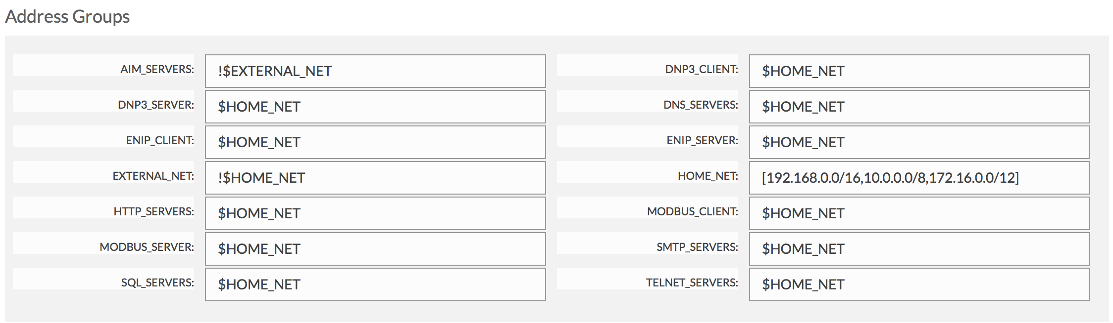
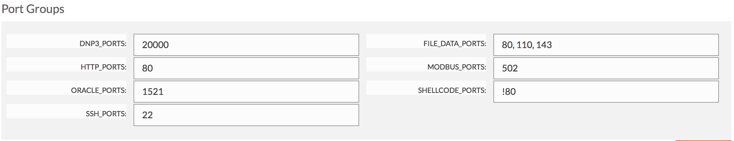
Snort/Suricata Variables capture context

Slide 18
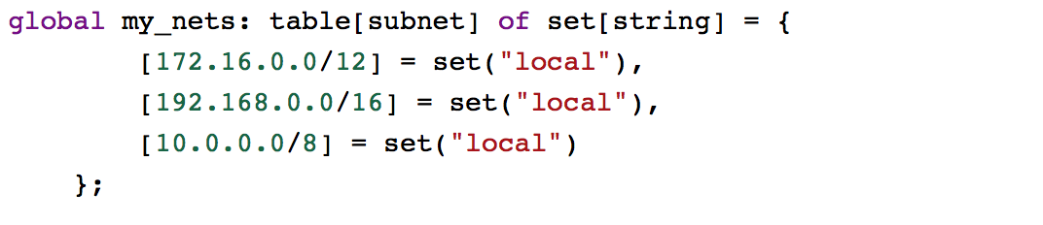
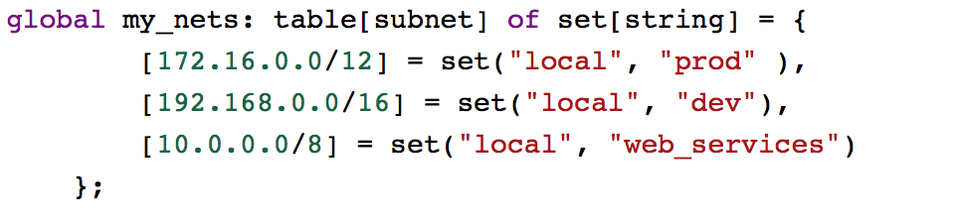
Site::local_nets also provides context

Slide 19
Other types of IP/Subnet labels
Environment Type
prod
Host Type
workstation
infrastructure
Network Segment
user
admin
val
dev
server
vpn/ras
vdi
Asset Value
critical
Function
domain_controller
non-critical
scanner
dns_resolver
Location
datacenter
hq_office
aws

Slide 20
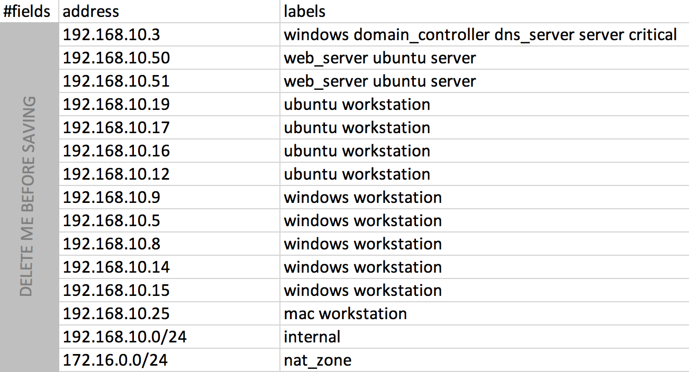
Format of cidr.labels file

Slide 21
Static Flow Labels
Defined as any combination of the 5-tuple fields
  orig IP, orig Port, resp IP, resp Port, Proto
Data flow direction, directional indicator based on PCR
  > PCR greater than 0.1, data flow from orig->resp
  < PCR less than -0.1, data flow from resp->orig
  = PCR greater than 0.1, data flow from orig==resp

Slide 22
Ways to label flows
Known - Has this flow been analyzed?
Authorized - T/F , Is this flow permitted by policy?
Suspicious - T if we should always consider this flow suspicious
Labels – Short strings that describe the flow

Slide 23
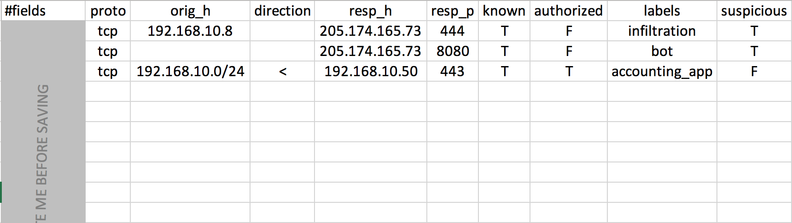
Format of the flow.label input file

Slide 24
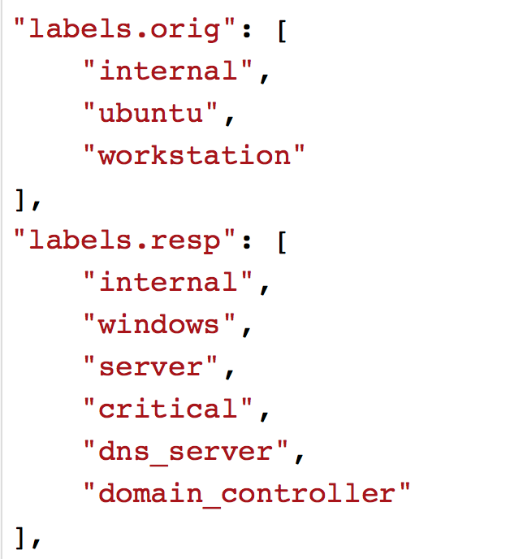
What happens behind the scenes?
Input files loaded into Zeek tables
Labels are accessible inside of event handlers
Log labels separately or have connections auto-enriched
Input Framework – Reading Data Into Tables
https://www.bro.org/sphinx/frameworks/input.html#id2
Notes:
bro automatically reads in the file and any updates to it after startup
the information is stored in two tables referred to as kb's or knowledge bases
connections have a new 'labels' field
the manager node registers for connection_state_remove events from the workers
the IP's and flow attribrutes are evaluated, applicable labels collected
connection record is enriched with static labels
flow_labeled event generated for handling in policy scripts
optionally log the labels record to a seperate log stream
handling labeled events is one way to take advantage of labeled flows
but we can also use these labels in other event handlers

Slide 25
Functions for using labels in script-land
ip_has_labels - check an IP for a list of labels
get_flow_labels - Retrieve all labels relevant to given connection
get_cidr_labels – Retrieve all labels relevant to a given IP address
add_ip_label – Add a label to a given IP address

Slide 26
Dynamic Labels
Labels can also be added in real-time
Add a label directly to the connection
Add a label to the IP's kb entry
Dynamic labels in the kb have a limited lifespan
Think short-term behavioral profiling

Slide 27

Label scans with scan.bro
Only track scan stats for IP’s the shouldn’t be scanning
When a scan is detected, add a label

Slide 28
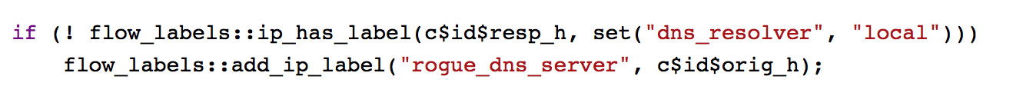
Suspicious DNS server activity
DNS to unknown (someone else's) DNS resolvers
Internal systems acting as DNS servers

Slide 29
Label Possible Lateral Movement
Don’t track stats for hosts that exhibit this behavior
When related behavior is observed, add a label

Slide 30
Other uses of Enriched Network Data
Filtering
Aggs/Stats
Policy Enforcement/Validation
Enhanced Correlations
Labeling for ingest in ML systems

Slide 31
Applications in AI
Static and Dynamic labels can be used together to provide rich descriptors for AI
Use conditions in Zeek Script to accurately label conn’s as they are seen
Known+authorized can be useful in model training; e.g. mark benign traffic

Slide 32
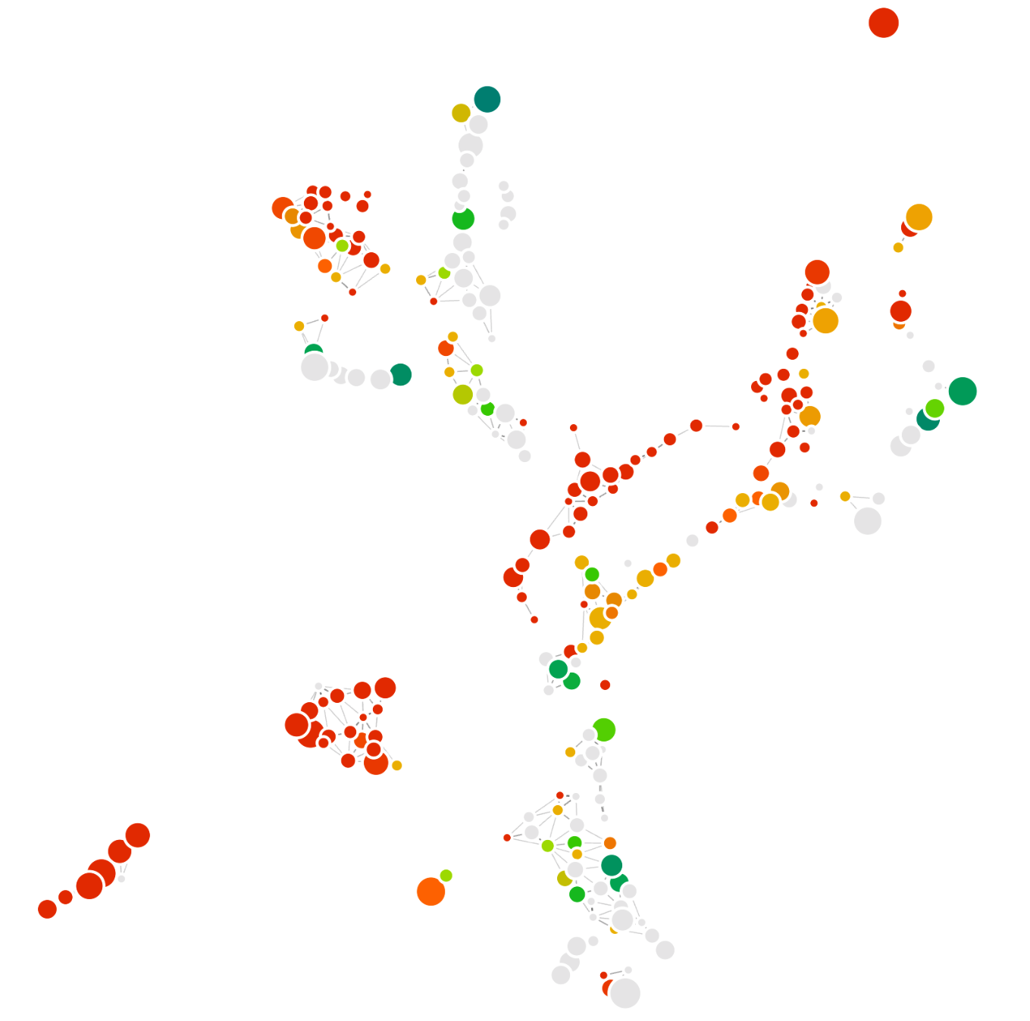
Categorical labeling

Slide 33
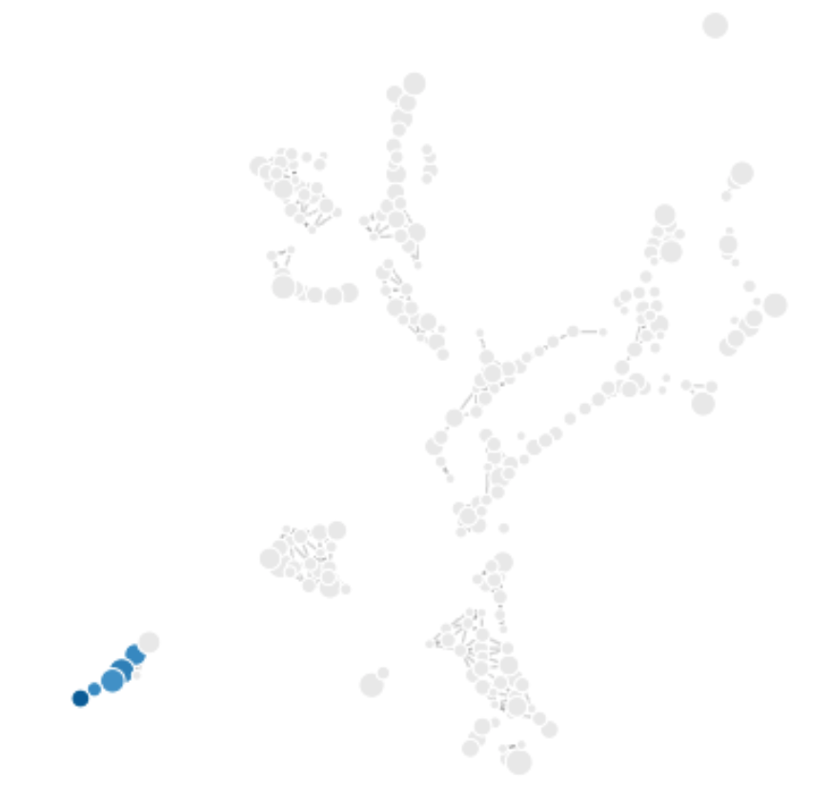
Training supervised models
Bot

Slide 34
Ideas for enhancement
Reserved labels
Expand on use-cases
Dynamic labels from fingerprinting (ports/protocols, user agents)
General code improvements

Slide 35
Get the code
https://github.com/bricata/flow_labels
Also available as a Zeek package

Slide 36
THANK YOU!

